Slide 1
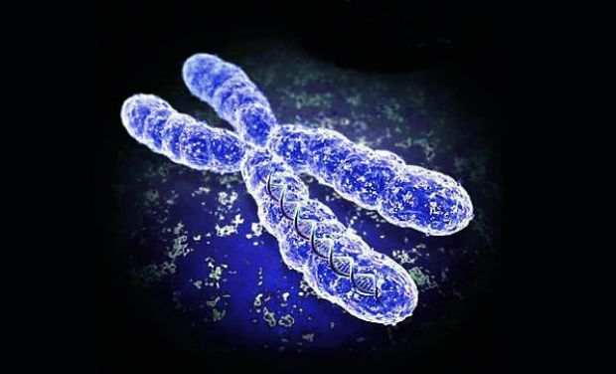
Chromosome and its Structure

Slide 2
Chromosome
Chromosome means: chroma - colour; some - body)
E. Strasburger in 1875 discovered thread-like structures which appeared during cell division
Waldeyer coined the term chromosome first time in 1888.
In all types of higher organisms (eukaryote), the well organized nucleus contains definite number of chromosomes of definite size, and shape.

Slide 3
A chromosome is a thread-like self-replicating genetic structure containing organized DNA molecule package found in the nucleus of the cell

Slide 6
Chromosomes are seen during metaphase stage of mitosis when the cells are stained with suitable basic dye and viewed under light microscope.

Slide 8
The somatic chromosome number is the number of chromosomes found in somatic cell and is represented by 2n (Diploid)
The gametic chromosome number is half of the somatic chromosome numbers and represented by n (Haploid)
The two copies of chromosome are ordinarily identical in morphology, gene content and gene order, they are known as homologus chromosomes.

Slide 9
Chromosomes are of two types
Autosomes: that control characters other than sex characters or carry genes for somatic characters.
chromosomes (Gonosomes) – Chromosomes involved in sex determination

Slide 10
Humans and most other mammals have two sex chromosomes X & Y, also called heterosome
Females have two X chromosomes in diploid cells; males have an X and a Y chromosome
In birds the female (ZW) is hetero-gametic and male (ZZ) is homo-gametic

Slide 11
Diploid and Haploid chromosome number
Diploid cells (2N where N- chromosome number) have two homologous copies of each chromosome
The body cells of animals are diploid
Haploid cells (N) have only one copy of each chromosome
In animals, gametes (sperm and eggs) are haploid

Slide 12
Chromosome number varies from 2n = 4 (n = 2) to 2n = > 1200. (n = gametic or haploid chromosome number 2n = somatic or diploid chromosome number)
The number of chromosomes varies from species to species
Normally all individual of a species have the same chromosome number

Slide 15
The size of chromosome is normally measured at mitotic metaphase and may be as short as 0.25 µm in fungi and birds, or as long as 30 µm in some plants like Trillium
Each chromosome has two arms - p (the shorter of the two) and q (the longer).

Slide 16
Chromosome shape is usually observed at anaphase, when the position of primary constriction (centromere) determines chromosome shape
This constriction or centromere can be terminal, sub-terminal or median in position.

Slide 17
Homologous Chromosomes
Diploid organisms have two copies of each chromosome (except the sex chromosomes)
Both the copies are ordinarily identical in morphology, gene content and gene order and hence known as homologous chromosomes.

Slide 18
Each pair of chromosomes made up of two homologs
Homologous chromosome is inherited from separate parents; one homolog comes from the mother and the other comes from the father.

Slide 19
Special Types of Chromosomes: Polytene Chromosomes
It was discovered by Balbiani (1881) and named by Koller
The nuclei of the salivary gland cells of the larvae of dipterans like Drosophila have unusually long and wide chromosomes, 100 or 200 times in size of the chromosomes in meiosis and mitosis of the same species

Slide 21
Salivary gland cells do not divide after the glands are formed, yet their chromosomes replicate several times (a process called endomitosis) and become exceptionally giant-sized

Slide 22
The giant chromosomes consist of a bundle of chromosomal fibrils which arise by a series of about 10 consecutive duplications of the initial chromonemata that increase the DNA content about 1000 times than the DNA content of somatic cells

Slide 23
The endomitosis process result in the production of 2X chromosomes, where X gives the number of multiplication cycle
Because of the multi-stranded condition, these chromosomes are called polytene chromosomes

Slide 24
The polytene chromosomes bear along their entire length a series of dark bands alternated by light bands or inter-bands
The dark bands are narrow or broad disc shaped structures
They are euchromatic in nature and contain large amount of DNA, small amount of RNA and certain basic proteins

Slide 25
The light bands or interbands are fibrillar, heterochromatic regions containing small amount of DNA and large amount of RNA and acidic proteins
They have alternating dark and light bands
The dark bands are disc-shaped structures occupying the whole diameter of chromosomes and it contains euchromatin
The light bands are fibrillar and composed of heterochromatin

Slide 26
During certain developmental stages, the single bands or adjacent bands of polytene chromosomes produce local reversible swellings which are called ‘chromosomes puffs’ or bulbs
The chromonemata of polytenic chromosomes give out many series of loops laterally
These loops or rings are known as the balbiani rings and they are rich in DNA and RNA

Slide 27
Lampbrush Chromosome
Lampbrush chromosomes are special type of giant chromosomes found in the nuclei of oocytes of many vertebrates, such as fishes, amphibians, reptiles and birds
It was first observed by Flemming in 1882 and given the name by Ruckert in 1892
Formed during the diplotene stage in the nuclei of oocytes during the active synthesis of mRNA molecules for the future use

Slide 29
These chromosomes may sometime become even larger than the polynemic or polytenic chromosomes of salivery glands of dipterans
The largest chromosomes may sometime be as long as 1 mm in urodele amphibians.

Slide 30
These chromosomes consist of main axis and many fine lateral projections or loops which give them the appearance of a test tube brush or lampbrush
Physiological studies indicate that the loops of lamp-brush chromosomes and balbiani rings of polytene chromosomes are the sites of active genes

Slide 31
B Chromosomes
Many organisms have a special chromosome in addition to the autosomes which are called B chromosomes
Also termed as supernumery or accessary chromosomes or accessory fragments
Smaller that autosomes and the number varies from 0 to 30/ cell

Slide 33
In some animals they may be derivatives of sex chromosomes
May have negative effects on the cell

Slide 34
Holokinetic Chromosomes
In insects of the order Hemiptera and in some monocotyledonous plants the kinetic acitivity is distributed over the entire chromosome
The term diffuse centromere has been used as an alternative
In 1966 Flach observed this type of centromere in some primitive Dicotyledons along with pseudoscorpion and Ascaris

